Slide 1


Slide 2
Appendix (*)
User personas
User stories
Empathy map
User flows
User scenarios
Sitemap
Wireframe
Storyboard
User journey scenarios
(*) collected from internet

Slide 3
1. User personas
A user persona is an archetype or character that represents a potential user of the website or app.
In user centered-design, personas help the design team to target their designs around users.
In user research, UXers will gather data related to the goals and frustrations of their potential users. Then, they create personas to put that data into context.
There is usually more than one type of user who will interact with your website or app, and creating personas helps to scope out the range of users.
User personas are essential in helping the design of website or app to meet the needs of users.

Slide 4
1. User personas
 | Who are they? | What is their main goal? | What is their main barrier to achieving this goal?
Simple user persona | < Write your user persona’s key demographic here > | < Write your user persona’s main goal here > | < Write your user persona’s main barrier here >
Administrative assistant persona | Administrative assistant working for large companies. | They want to create Word documents from printed documents handed over to them or PDF documents where the source has been lost. | They struggle to do so because converting printed docs or PDFs docs to fully editable Word documents is super difficult without Optical Character Recognition (OCR). Most of them end up manually recreating them.

Slide 5
1. User personas
Status | de facto King of House Stark
Archetype | dashing hero
Personality | humble, loyal, brave
Motivations | fear, honor, peace
Goals | remove the threat of the White Walkers from the North, incidentally become King of the Iron Throne
Frustrations | he knows nothing, he’s not a true Stark
Bio | Jon has a clear moral compass and a true sense of honor, having learned from a series of difficult life events. He has a legitimate claim to the Iron Throne and is a great leader. He is also one of the only people to take the White Walker threat seriously.

Slide 6
2. User stories
Usually one user story per user persona. There are often multiple user personas – it’s a good thing that user stories are brief!
It’s super simple to write a user story. Code squeeze has it down pat:
“As a [role], I want [feature] because [reason].”
Example:
“As UX Manager, John wants centralized assets management so that his designers are in sync.”
“As a UX Manager, John oversees all the design projects, including assets creation and prototyping efforts, at the design consultancy where he works. He needs easy access to a design tool that allows him to centralize UI libraries so that multiple designers to work simultaneously on a prototype.”

Slide 7
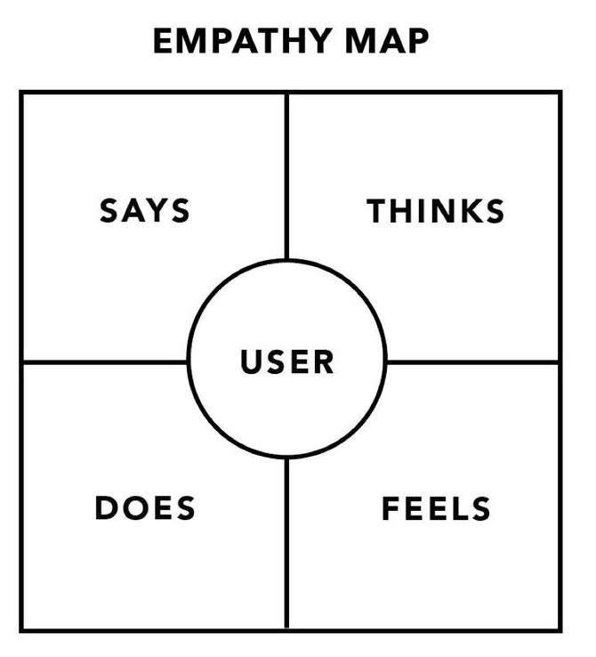
3. Empathy map

Slide 8
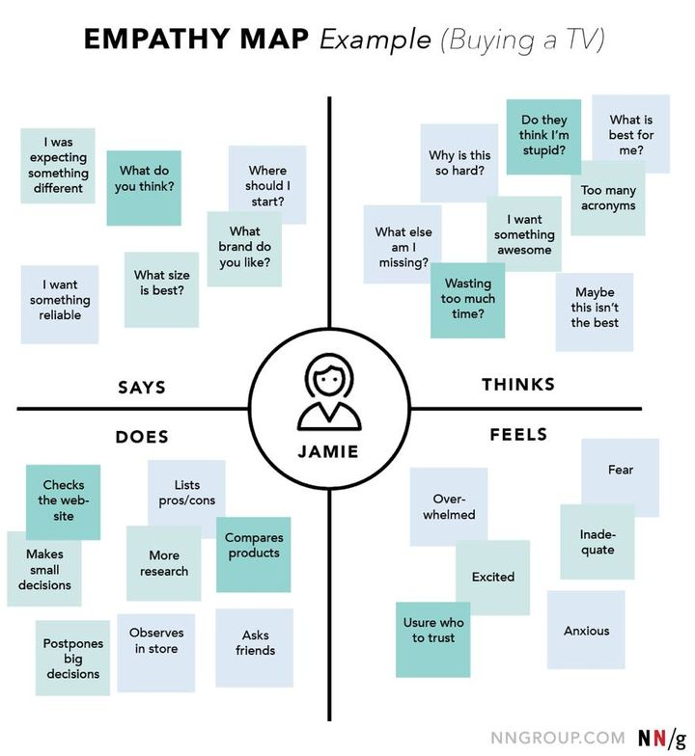
3. Empathy map

Slide 9
4. User flows
User flows tend to show a specific persona’s pathway through the design at hand.
A set or series of task flows can be embedded within user flows, but unlike task flows, user flows include decision points wherein the persona’s journey to the desired goal can differ, based on decisions the persona need to make in interacting with the design.

Slide 10
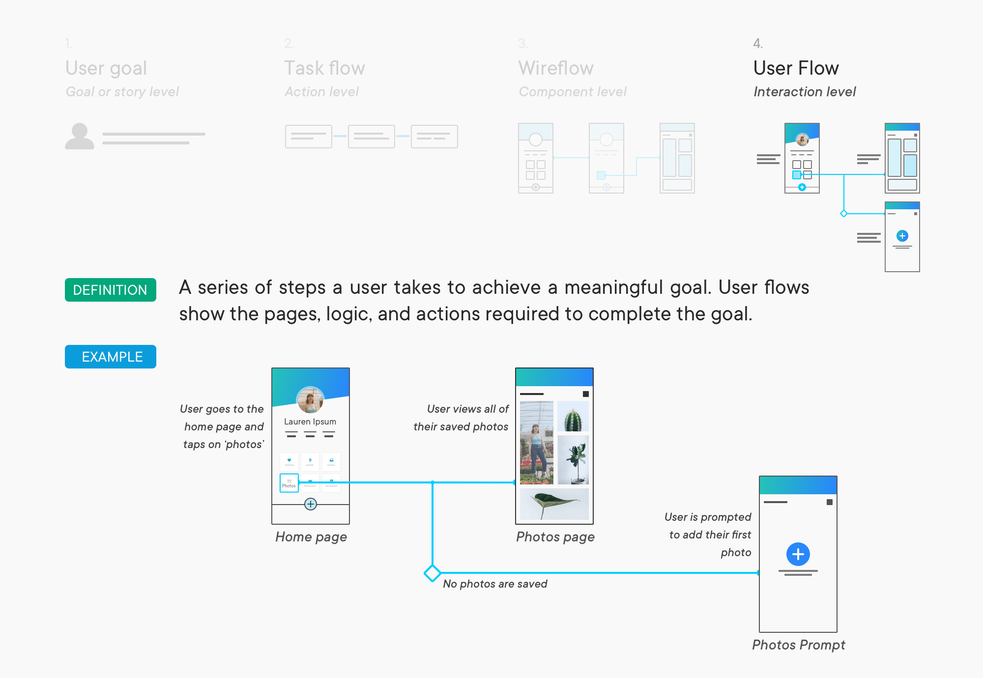
4. User flows

Slide 11
5. User scenarios
A scenario is a situation that captures how users perform tasks on your site or app.
Scenarios describe the user’s motivations for being onsite (their task or goal) and/or a question they need answered, and suggest possible ways to accomplish these objectives.
It is essentially a development of the user story, and can relate to multiple target users. However, scenarios can also be broken down into use cases that describe the flow of tasks that any one user takes in a given functionality or path.

Slide 12
5. User scenarios
Mr. and Mrs. Macomb are retired schoolteachers who are now in their 70s.
Their Social Security checks are an important part of their income.
They've just sold their big house and moved to a small apartment.
They know that one of the many chores they need to do now is tell the Social Security Administration that they have moved.
They don't know where the nearest Social Security office is and it's getting harder for them to do a lot of walking or driving.

Slide 13
5. User scenarios
If it is easy and safe enough, they would like to use the computer to notify the Social Security Administration of their move.
However, they are somewhat nervous about doing a task like this by computer.
They never used computers in their jobs. However, their son, Steve, gave them a computer last year, set it up for them, and showed them how to use email and go to websites.
They have never been to the Social Security Administration's website, so they don't know how it is organized. Also, they are reluctant to give out personal information online, so they want to know how safe it is to tell the agency about their new address this way.

Slide 14
6. Sitemap
A sitemap contains all documents—in other words, webpages—of a website, and presents them hierarchically.
The structure of the entire web presence is duplicated in this overview.
To understand it, you should briefly familiarize yourself with the set-up of a website: a basic website is comprised of individual HTML documents, which are stored in various folders and interconnected via hyperlinks.
All of them together are found on the webspace. In the sitemap, pages are recorded along with corresponding URLs.

Slide 15
6. Sitemap
In the early days of the World Wide Web, the sitemap was principally created to make users’ website navigation easier.
Often inserted as a frame in addition to the main content, sitemap documents gave visitors the opportunity to move from one site to another at any time, without having to click through individual hyperlinks one after the other.
Nowadays, the navigation process is usually solved much more elegantly, but the sitemap is still justified. For one thing, having this additional navigation tool can increase user-friendliness, and for another, search engines make use of these files.

Slide 16
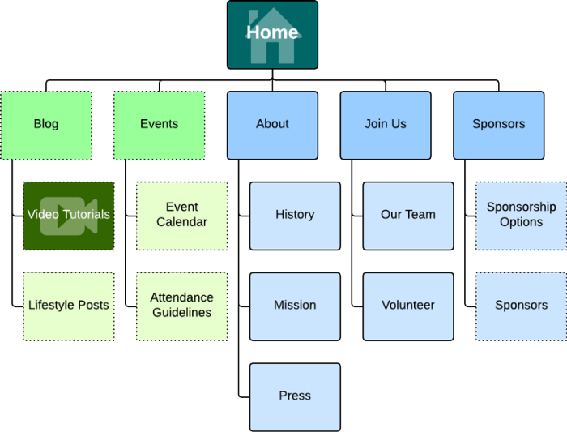
6. Sitemap

Slide 17
7. Wireframe
The process of creating a digital product is similar to the process of building a house. When we think about building a home, we usually mean the process of construction. And the first step of creating this appearance is creating blueprints — outlines of areas that give those involved in building a clear vision of the project structure.
A wireframe is like an architectural blueprint in the design process. It serves as a reference point for functional specifications and gives the product team a basis to begin creating screens. Wireframing is a step that should not be skipped.

Slide 18
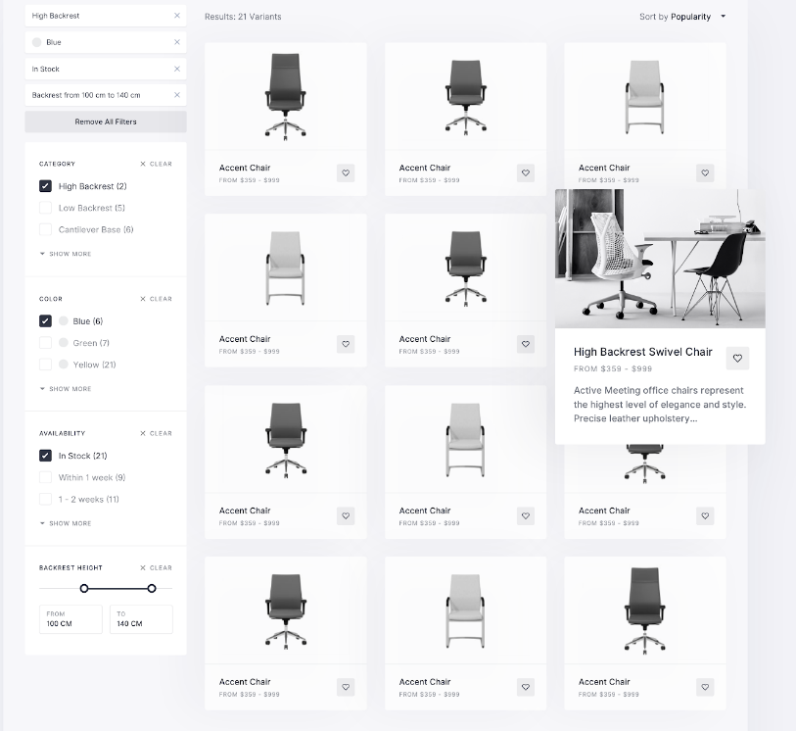
7. Wireframe
The products are distributed in an easy-to-scan grid. Each item in the grid contains essential information about the product — product image, name, and price.

Slide 19
8. Storyboard
A storyboard is a visual tool for exploring how an example user experiences a product. In a storyboard, a designer visually displays the process that a user may undergo in order to accomplish a goal. The process is called a user journey.
Storyboards and user journeys help product designers, engineers, and managers understand how users may interact with their products which, in turn, helps designers create more human-centered products.

Slide 20
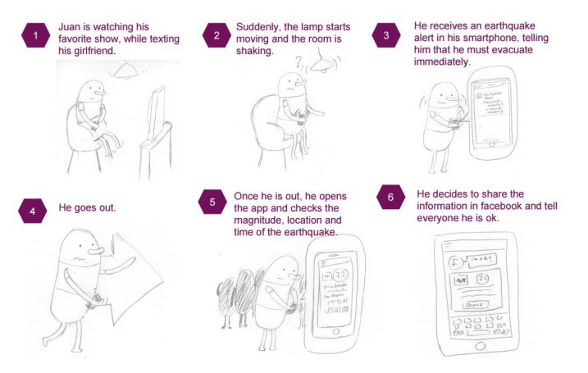
8. Storyboard

Slide 21
9. User journey scenarios
Jumping right into sketching interfaces or wireframing means that you’d miss an opportunity to find delightful experiences, delightful features that will help users accomplish their tasks easily.
Mapping out the user journey will help you define the customer experience of your design from start to end.
A user journey could be defined as a map of the actions and emotions that your user experiences while using your designs from start to finish.
User journeys come under many names, such as Customer Journey, Journey Map, Experience Map; everyone has a different name for it.
User Journeys define the motivations for using your app, they define the problems that your app solves for the user, they define the different phases of your app, and they define the experience from start to finish, as well as emotions and feelings that the user may have along the way.

Slide 22
9. User journey scenarios
A Journey Map will help you plot out your Journey. You’ll see the different stages, and along each way for each state, you can specify the user goals, as well as details and perhaps something about the environment, and maybe what’s going through the user’s mind along the way, as well as their emotions.
If any ideas come to you as you’re mapping this out, feel free to write them. Just make this as realistic as possible.

Slide 23
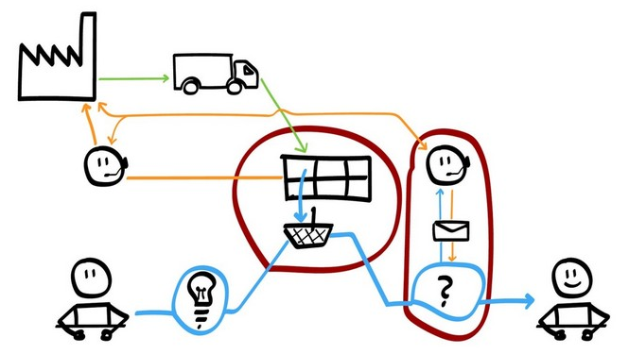
9. User journey scenarios

Slide 24
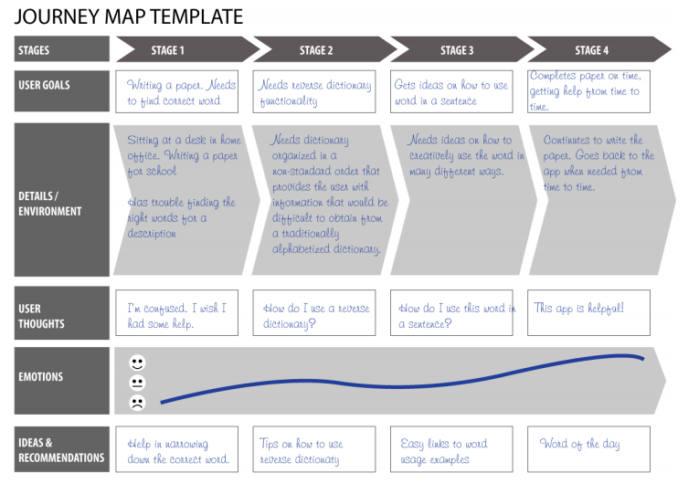
9. User journey scenarios

Slide 25
Reference
http://www.oamk.fi/~teraisan/K1033BI/02.1User%20interface%20design.ppt
http://www.mackayhouse.com/Scott/An%20Introduction%20to%20Core%20User%20Experience%20Concepts.ppt
https://ddcsubjectmaterial.files.wordpress.com/2014/04/chapter-08_designing-the-interface.ppt
http://web.fsktm.um.edu.my/~salwa/HCICourse/lecture3/User-Centered-Design.ppt#:~:text=The%20quality%20of%20interaction%20between,goal%20of%20user%2Dcentered%20design

Slide 26
Questions

Slide 27

Thank you for​ your attentions!​

